Slide 1
Research and Innovation: trends and impact into the society
On. Prof. Maria Chiara Carrozza
Camera dei Deputati
Scuola Superiore Sant’Anna

Slide 2
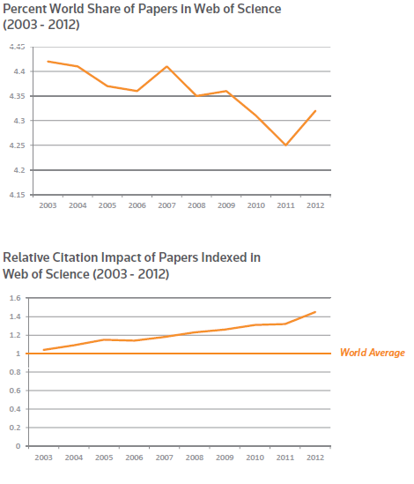
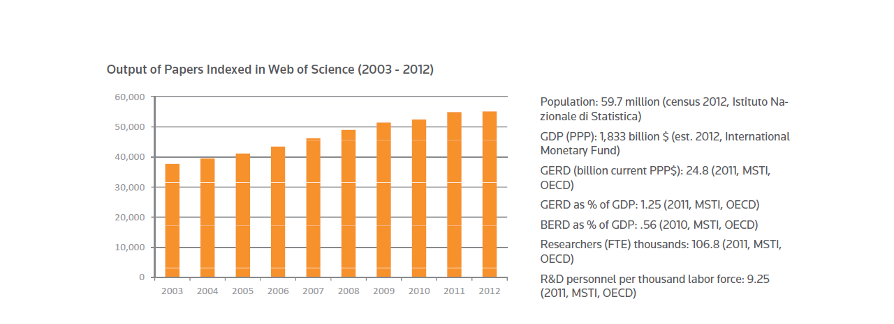
Population: 59.7 million (census 2012, Istituto Nazionale di Statistica)
GDP (PPP): 1,833 billion $ (est. 2012, International Monetary Fund)
GERD (billion current PPP$): 24.8 (2011, MSTI, OECD)
GERD as % of GDP: 1.25 (2011, MSTI, OECD) BERD as % of GDP: .56 (2010, MSTI, OECD)
Researchers (FTE) thousands: 106.8 (2011, MSTI, OECD)
R&D personnel per thousand labor force: 9.25 (2011, MSTI, OECD)
Fonte: The Research and innovation performance of the G20 Thompson Reuters

Slide 3
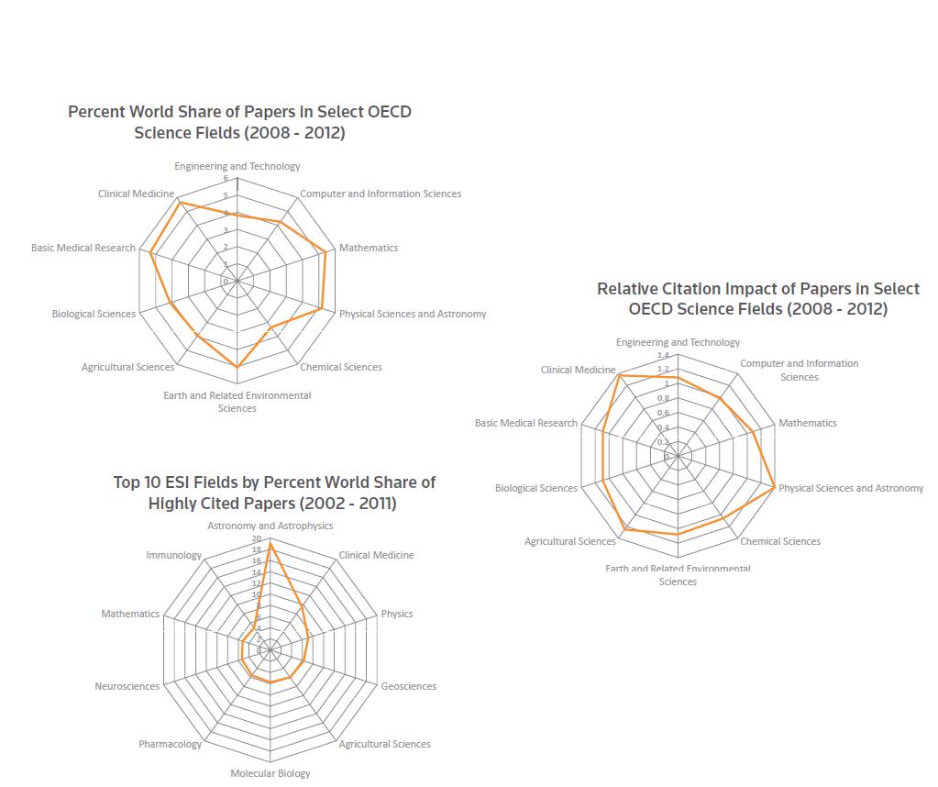
Citation Impact of Italian Research

Slide 5
EMPOWERMENT OF RESEARCHERS
Italian researchers are one of the excellence of the Country that guarantee Italy’s reputation
Italy is ranked in the top 5 for cross border scientific publications: with 499.8 publications per 1 M citizens, Italy is well above EU average*
Granting researchers autonomy is a priority. They need to purse their studies and research, build up their careers
Granting autonomy
leads to Empowerment
* Data from Researchers’ Report 2013, DG Research & Innovation

Slide 6
Challenge Prize
Empowering Researcher doesn’t mean leaving them in the ivory tower of Academia.
The Peer Review methods are showing their weaknesses compared to well coordinated crowdsourcing dynamics.
Inducement Prize:
this new instrument is changing
open innovation’s dynamics
i.e. NASA’s Centennial Challenges;
H 2020, EU Commission will launch
three ICT-related inducement prizes in 2014-2015.

Slide 7
Multilateralism
Academy = Multilateralism
European Commission: “the benefits of mobility across institutions, disciplines, countries and sectors are becoming increasingly recognized”
Italian PhD students mobility: 37% (EU: 23%)
PostDoc cross-sectoral mobility: 6% (EU: 30%)
* Data from Researchers’ Report 2013, DG Research & Innovation
The EU achieves its goals
when it uses
a multilateral approach.

Slide 8
Pay to be unbiased
Italian Scholars
are significantly underpaid
Pros
Stimulus for individual creativity
Proactivity in networiking
Crowdsourcing and communities of intermediaries
Engagements with other institutions
Cons
Entropy
Depletion of the institution
“Follow the money”
Lack of independence

Slide 9
Complexity matters
“My focus is on what science
can do to deliver better policies and
ultimately a more rewarding
life for all of us. […]
So I am here to say
what science can do for you,
rather than asking
what you should do for science.”
Prof. Anne Glover,
Chief Scientific Adviser,
European Commission
High complexity of technical issues.
Democratic institutions
play the decision-maker role, but they need to be advised.

Slide 10
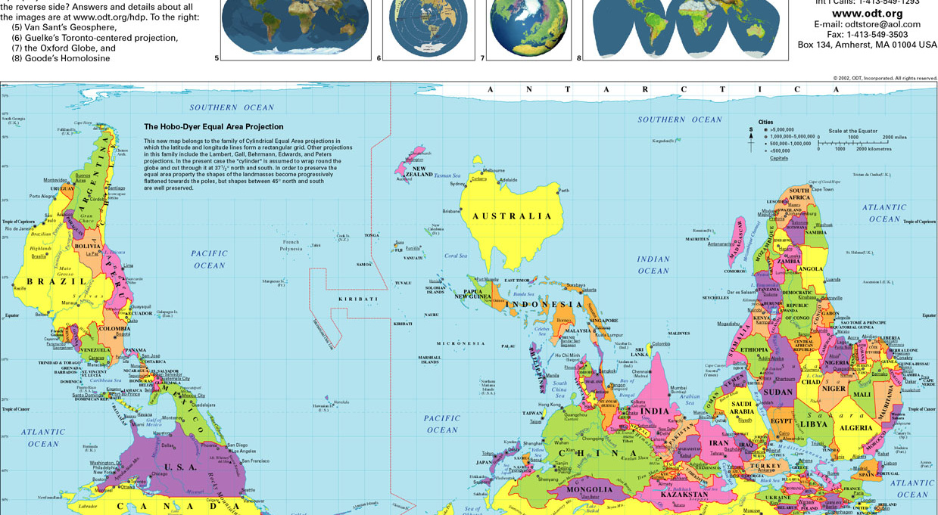
Education is universal and trains people to look at the world from different perspectives

Slide 11

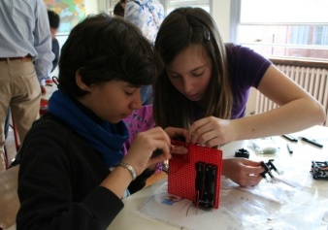
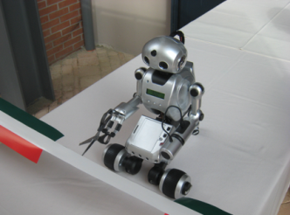

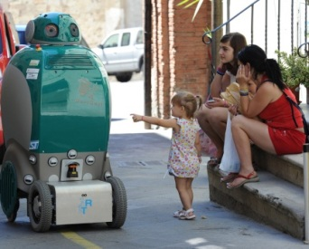

Pursuing new frontiers in engineering, by integrating science and technology
Frontier Research
Advanced Education
Exploitation and Technology Transfer
We aim at educating a new kind of engineers who are researchers, inventors, and entrepreneurs. Our students are trained to work in teams, on complex and interdisciplinary problems, and in a deeply international network

Slide 12
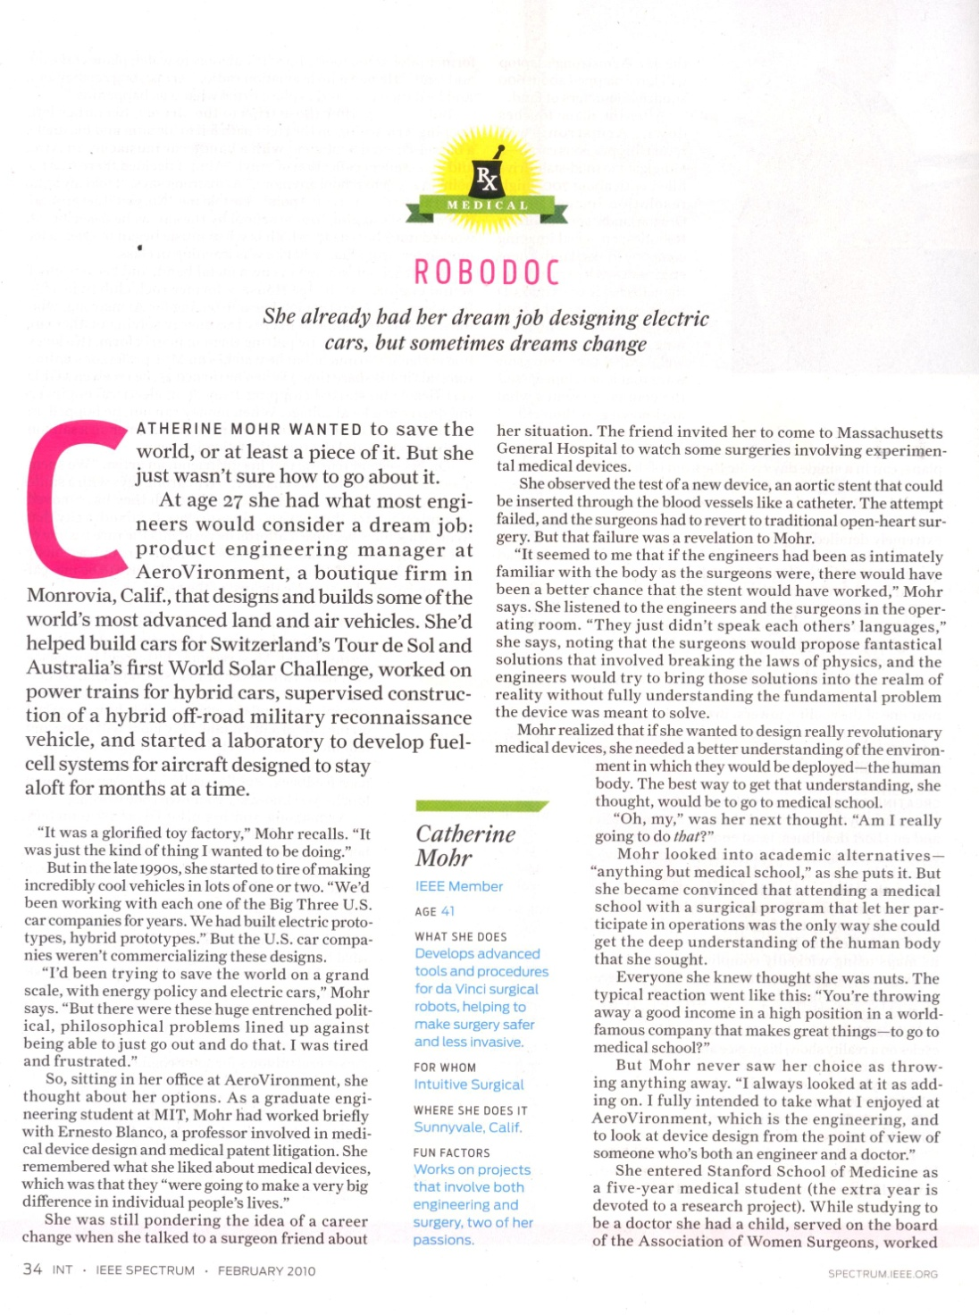
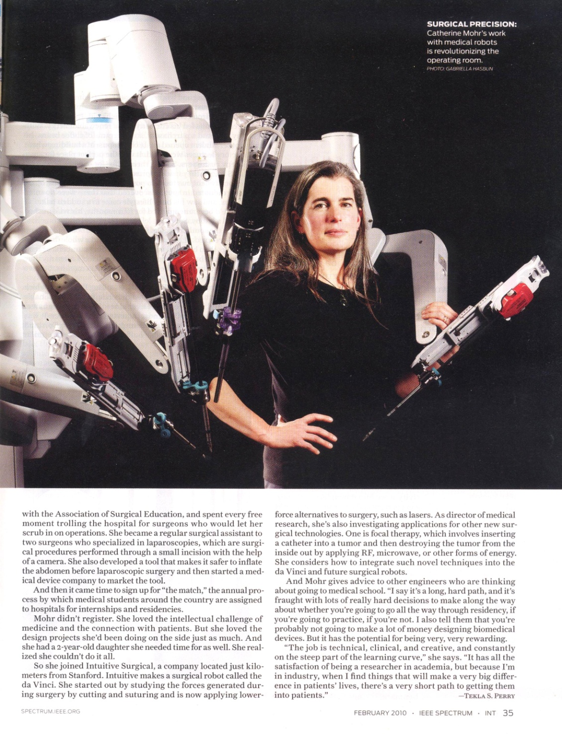
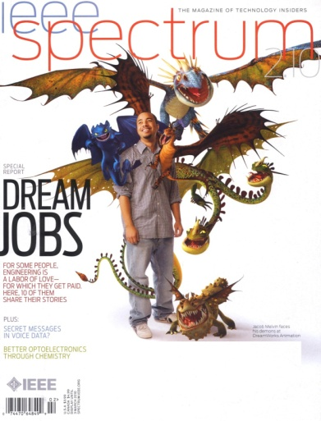
Engineers design things and solve problems. They’re educators, explorers, and entertainers, as well as builders and problem solvers
Catherine Mohr at Intuitive Surgical

Slide 13
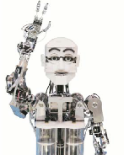
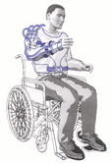
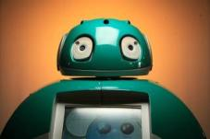
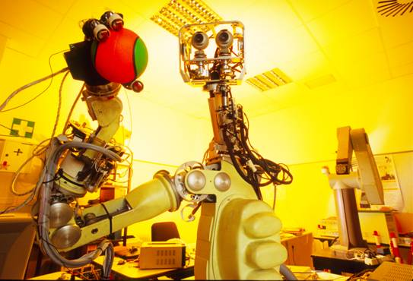
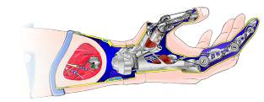

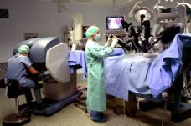
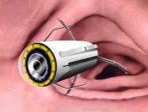
Educating the Engineer of the 21st Century
Innovation and Innovators:
INVENTORS, not just designers
ENTREPRENEURS, not only managers

Slide 14
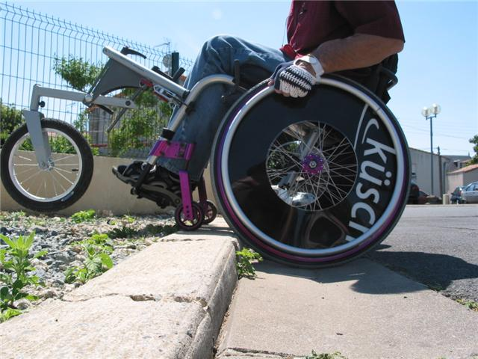
Social innovation

Slide 15
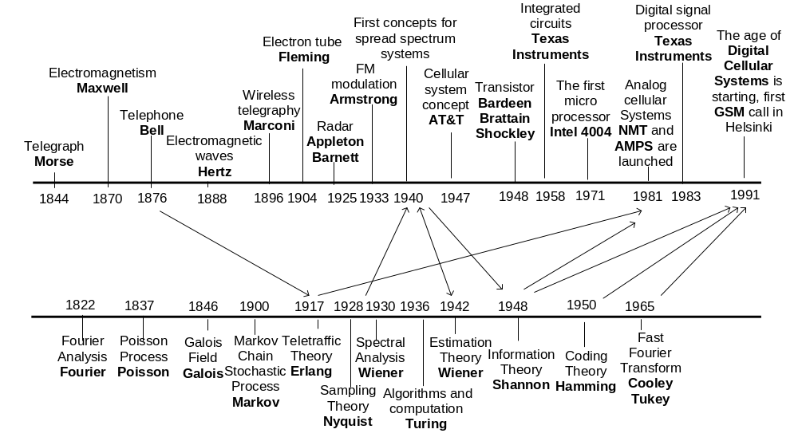
Historical Milestones of Technology and Mathematics Leading to Mobile Phone Systems
Source: Nokia
Notes:
15

Slide 16
Scientific knowledge (Discovery)
Prototypes, experiments
Factory, organization, management
?
Market
Problem (curiosity and application driven)
Invention
Design
Product
Research
Specifications
Industry
Going beyond traditional engineering education

Slide 17
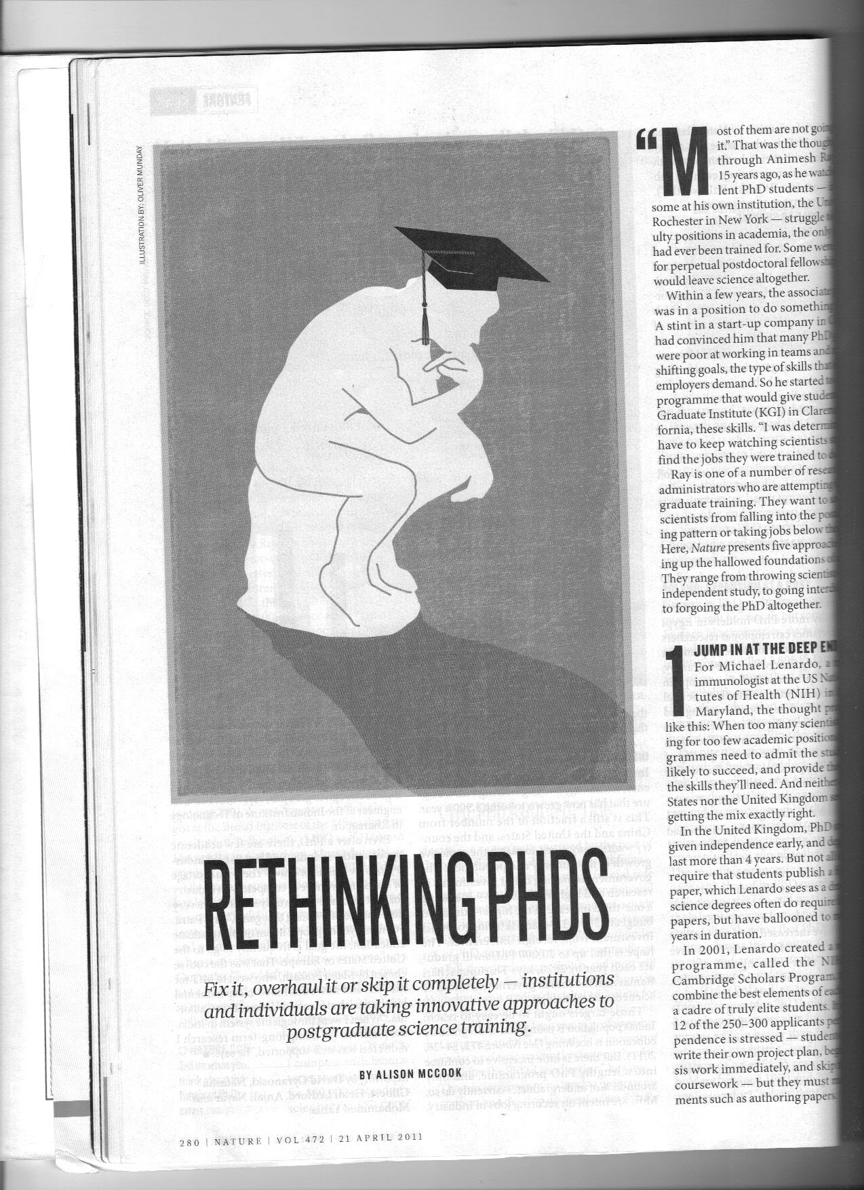
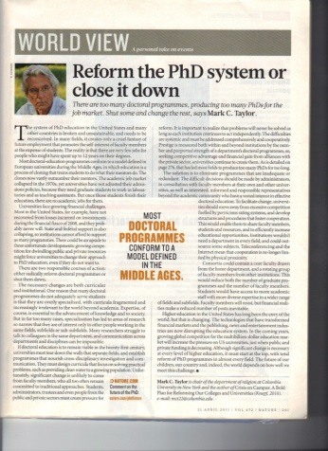
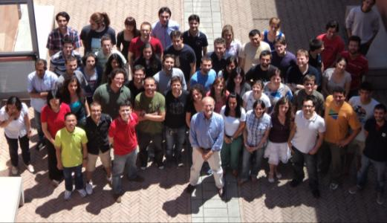
The PhD Model
Team work
Interdisciplinarity
Internationalization

Slide 18
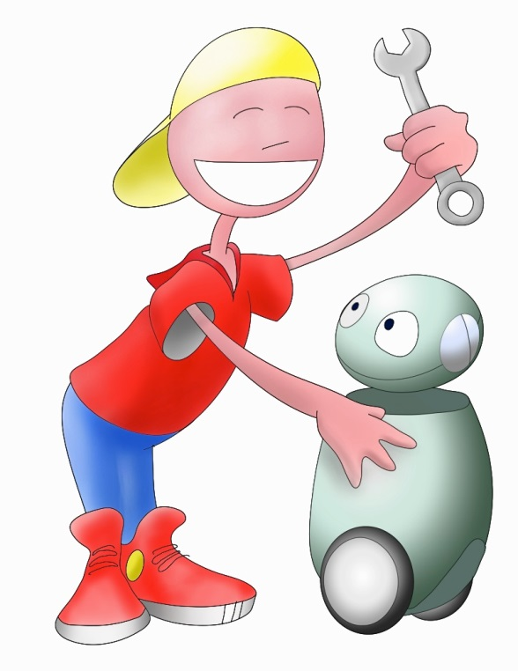

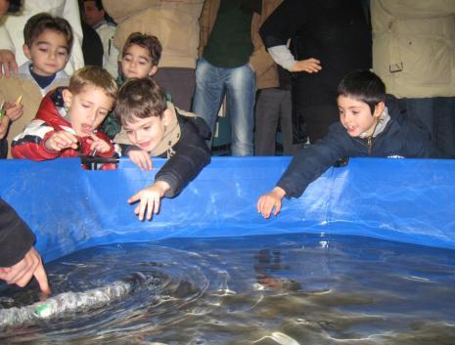
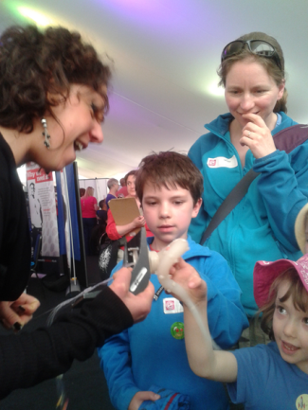
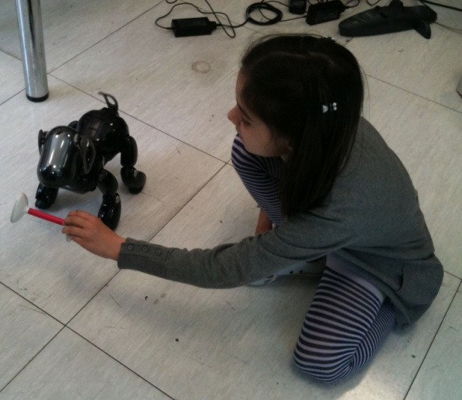
Educate young people in deploying and using robotic technologies
Robot companions at school help to develop a problem-solving attitude, foster a trans-disciplinary approach, encourage team work. In addition, increase children engagement with a student-centred learning approach.
Innovating the Education Programs
Our experience 2012-13
14 schools - 19 classes
20 teachers - 475 students
90 hours laboratory
Educational Laboratory on Robotics at the BioRobotics Institute

Slide 19
Strengthening education at all levels
Primary Education Schools
Secondary Education Schools
Pre-school (3-6 years old)
  Introduction to robotics
  Robot as interactive games
Elementary (6-11 years old)
  What is a robot?
  The robots already among us
  Manual activities
  Contest: robot design
Secondary schools (11-14 years old)
  Introduction to robotics
  Experimental activities using robotic kits
  Robot contests
(14-19 years old)
Advanced interdisciplinary course on robotics (Sciences Technologies and Humanities
Involvement of children/teenagers from 3 to 19 years

Slide 20
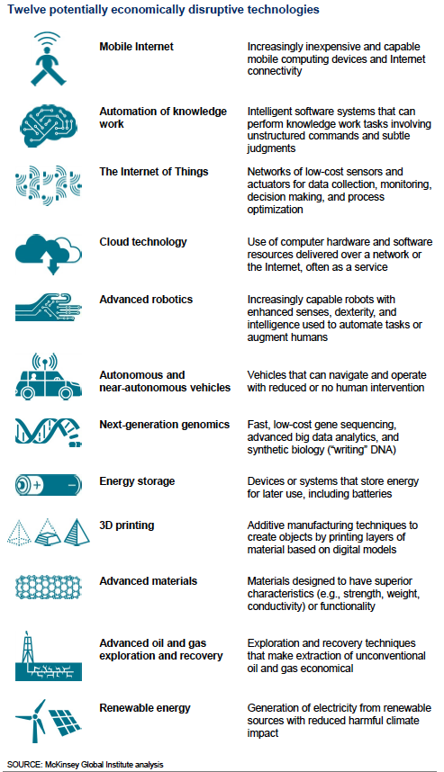
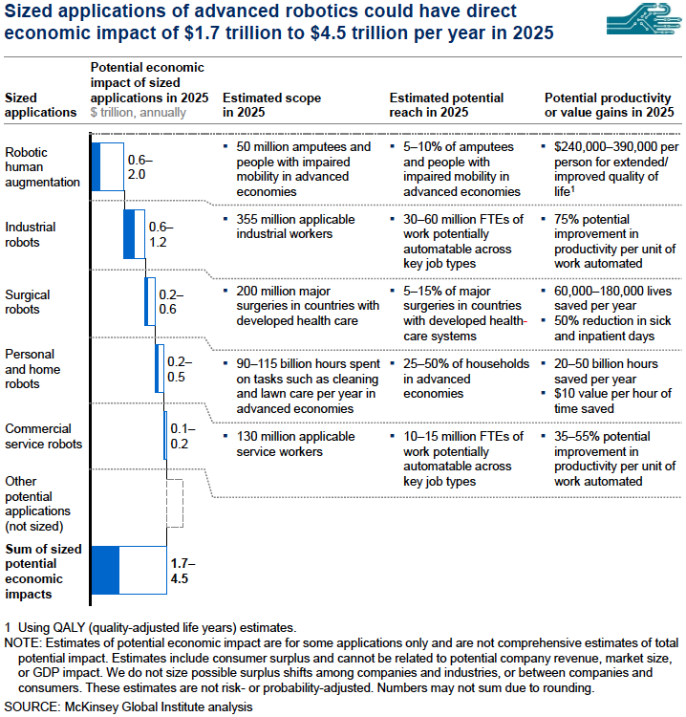

Slide 21


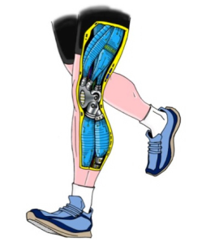




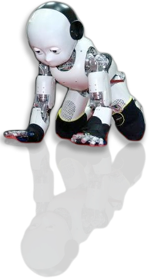

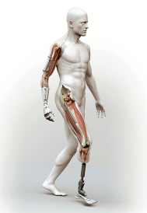

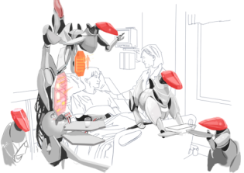
Robot will (?) drive a range of integrated industries and services
Vision, sensitive skin:
Sensor manufacturers
Decision making: computer and software manufacturers
Peratech
Interaction with human, communication: sociologist, designer, end user associations, phone manufacturers
Health, healing: insurances, pharmaceutics, social security, rehabilitation centers, hospitals
Security, surveillance: industry of safety,
Body: actuation, mechanicals, materials manufacturers
Transport: manufacturers
Energy: battery manufacturers
Notes:
Examples of industry and services required by RCC. Please add your own favorite picture.

Slide 22
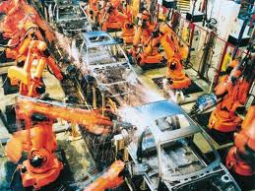
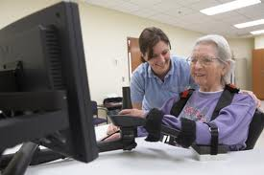

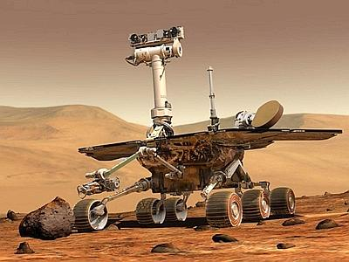
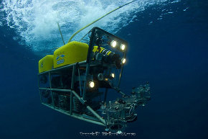
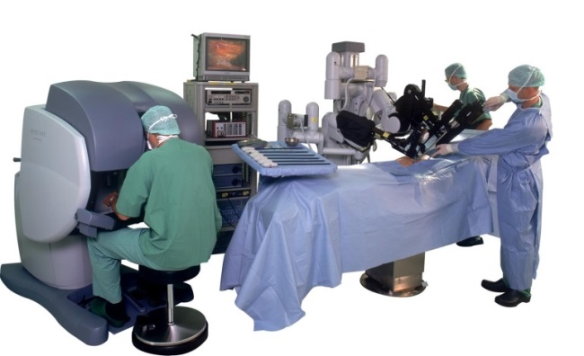
Robotics is going from specialized environments to our houses
At your place !
Therefore you will interact with your own robots
and you wiil share ideas and goals with them

Slide 23
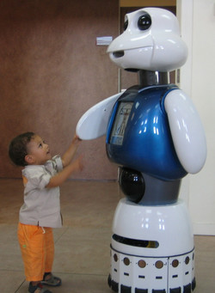
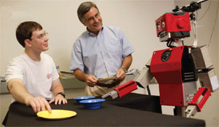
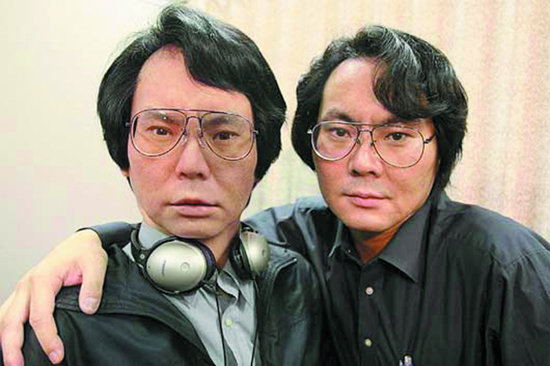
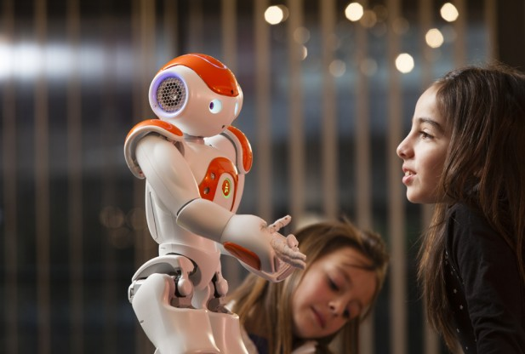
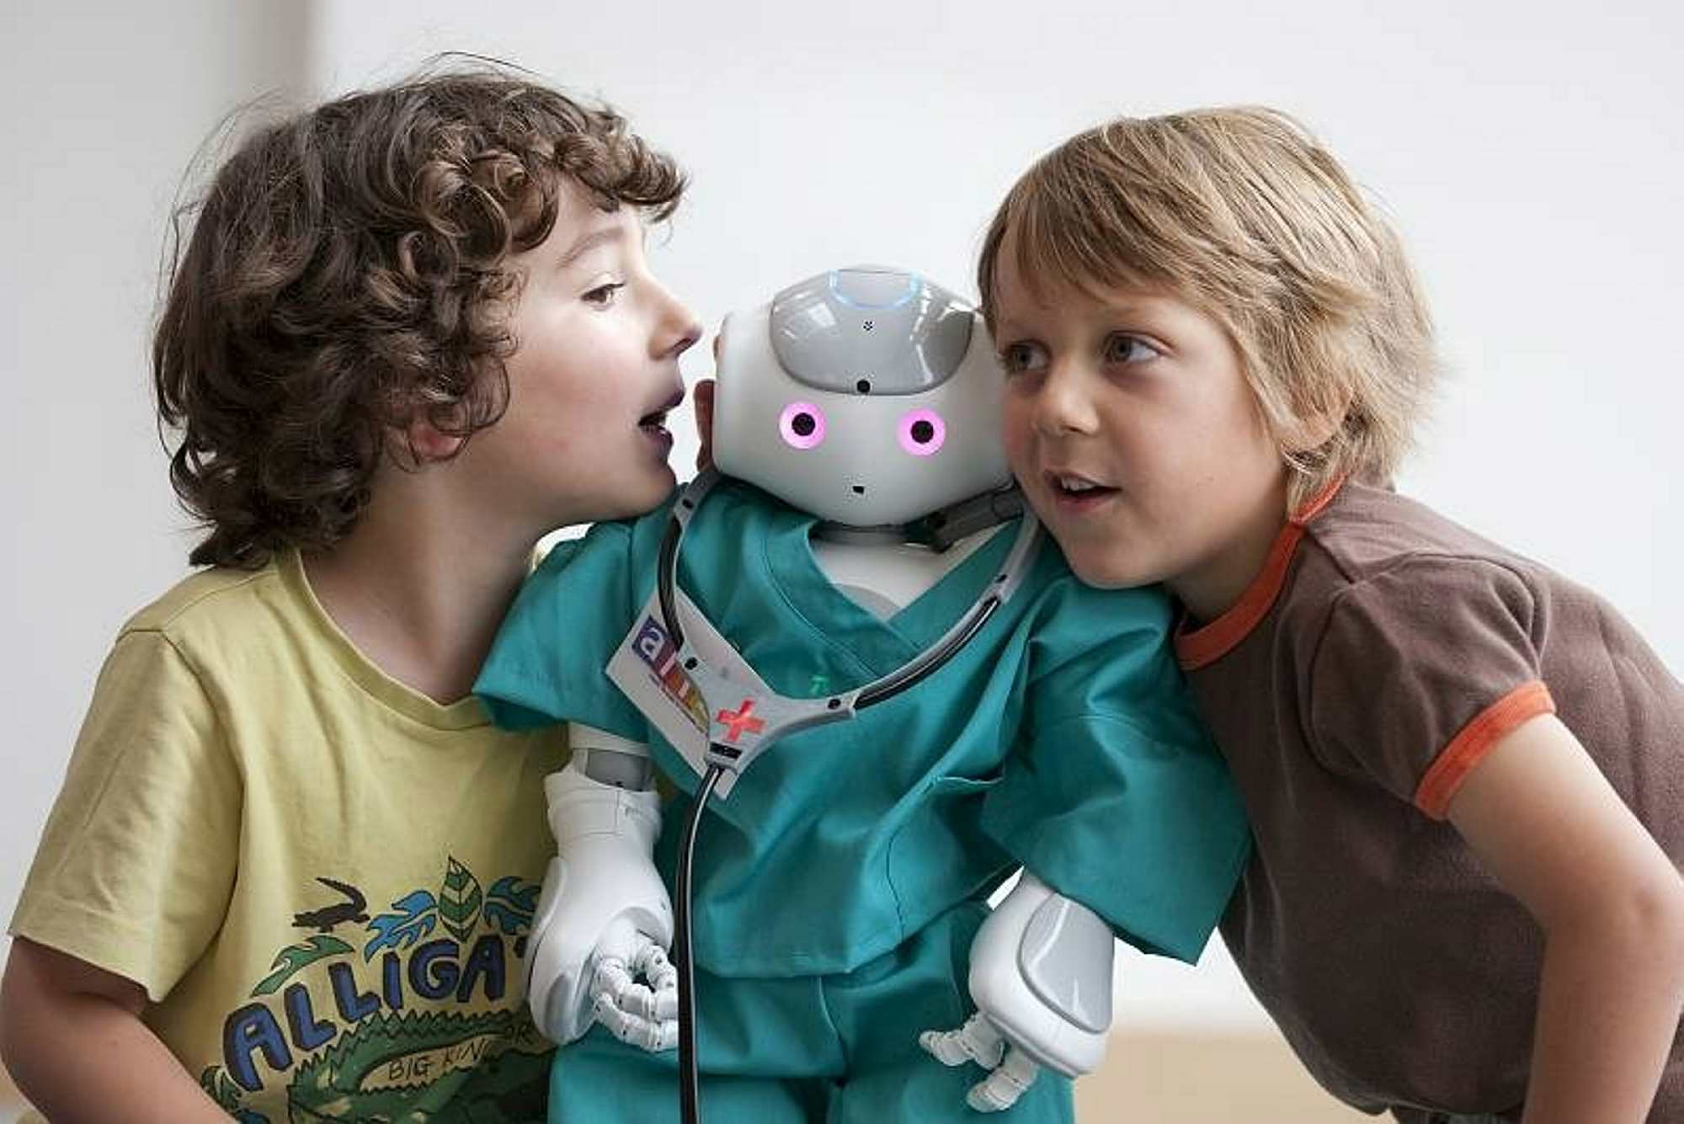
Robots will be our friends, assistants, waiters… Robotics is social

Slide 24
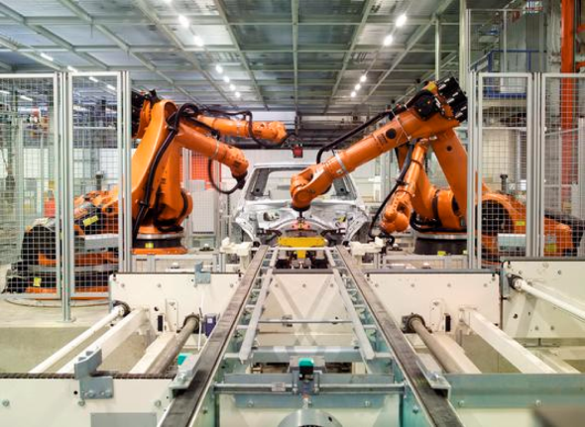
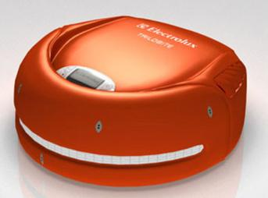
Robotics is a real market …
More than 1 million operational industrial robots in the world, with a growth rate of 6% per year
(Source: IFR)
Reliability of industrial robots:
Mean Time Before Failure = 40,000 hrs
Efficiency η > 99.99875%
(Source: COMAU)
Around 5 millions service robots are sold annually
Service robots are one of the fastest growing markets (~14% per year)
Professional service robots account for 80% of sales value
10.000.000+ Roomba Cleaning Robots sold so far!
(Source: IFR)
Notes:
24
People’s and Europe’s problems can have a common answer: robotics.
Today's robotics has great merits, as seen in the dependability of industrial robots and their crucial contribution to keeping Europe’s manufacturing base, but they perform well as long as they follow a fixed path and do not interact too closely with humans.

Slide 25
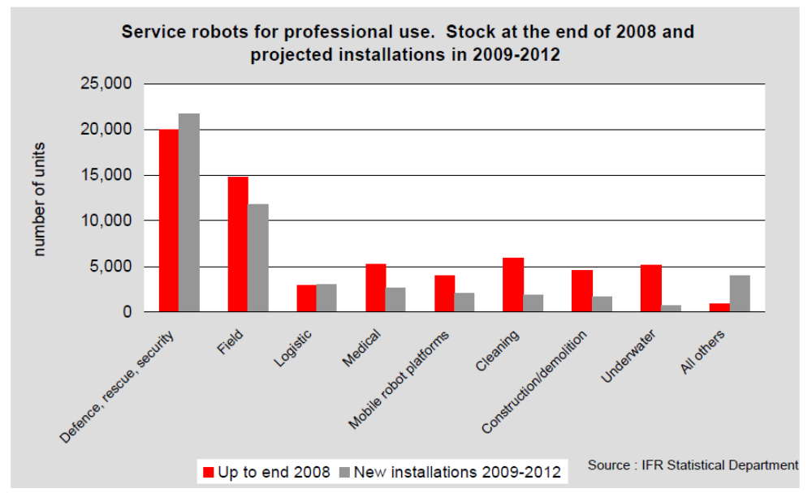
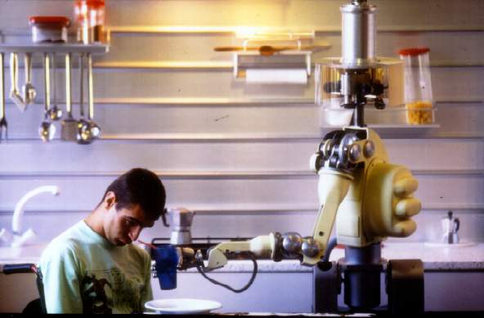
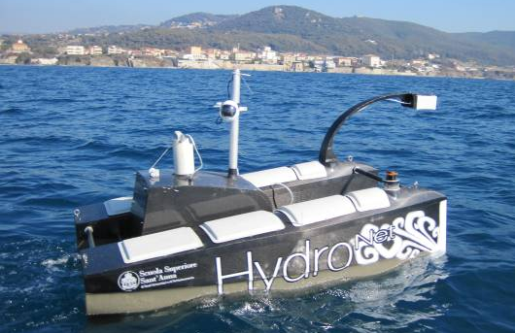
… and grows
Forecasts predict a 2-digit growth for the market of robots, in particular for service robots, and an even sharper growth for healthcare robots (in surgery, rehabilitation, assistance to elderly and disabled persons)

Slide 26
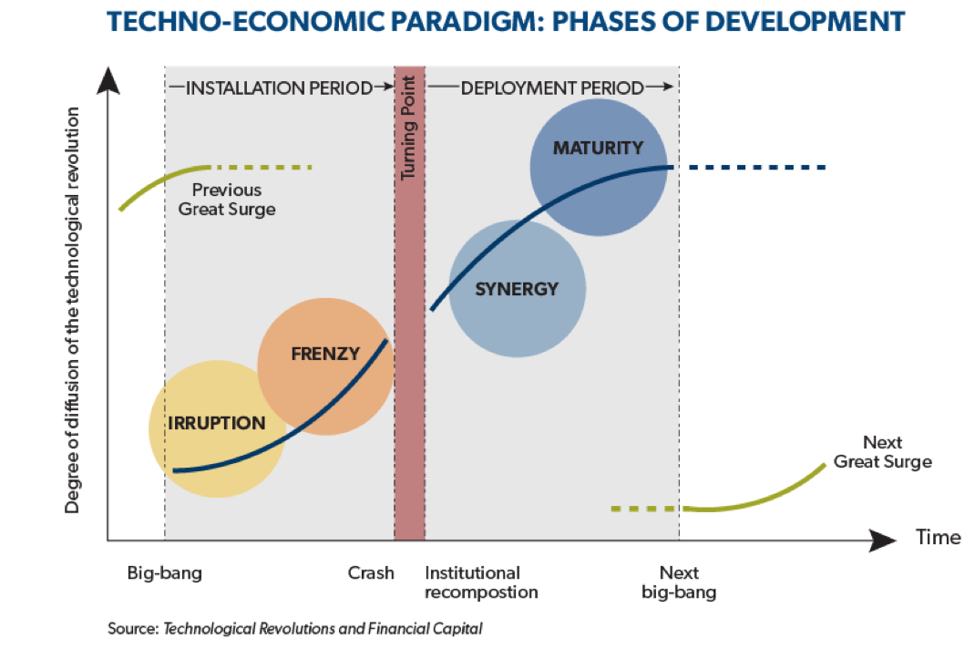
Robots could replace 80% of Jobs?
A new study (to be published) by Stuart Elliot (OECD analysis) indicates that technology could replace ‘workers for 80% of current jobs’
Despite the job losses in the US manufacturing sector factories are increasingly employing more skilled engineers to tend complex equipment and at higher wages
  Annual payroll per employee in the manufacturing sector rose from $45,818 in 2007 to $52,686 in 2012 (from The Enlightened Economy, Joel Mokyr)
- The question raised by Elliot is: “Even if alternative jobs are available, how will the displaced workers acquire the necessary skills for the new tasks?”
- This is the time to act to prevent the current society from strong inequalities deriving from this new machine revolution

Slide 27
Take on messages
Our behaviour will be affected by robots or by internet of things?
We will be better thanks to robots (?)
The combination of google and robotics will change our future?
Assessment of Researchers
More researchers
Change recruitment rules
Education and Training are essential (from primary school to university and longlife learning)
Research Agency and governance
Investing in teaching coding and robotics at early stages of education programs

