Slide 1
“Federalism, Electronic Commerce and
Public Finance in the US”
Interparliamentary Conference Under Article 13 of the Fiscal Compact
Camera dei Deputati and Senato della Repubblica
30 September 2014
Michael A. Pagano, PhD
Dean, College of Urban Planning and Public Affairs
Professor of Public Administration
University of Illinois at Chicago

Slide 2
Constitution of the United States of America
Article 1, section 8:
“To regulate Commerce with foreign Nations, and among the several States, and with the Indian Tribes”.

Slide 3
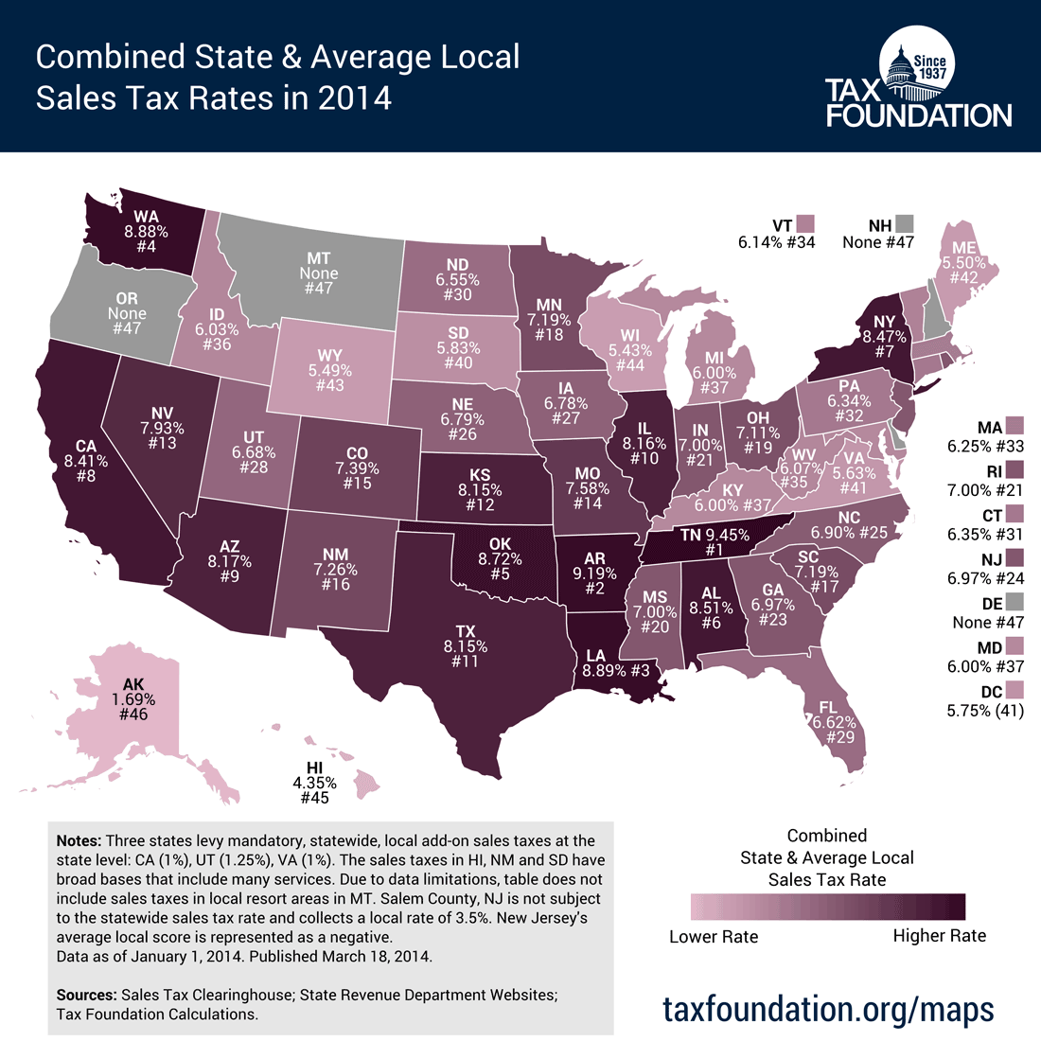

Slide 4
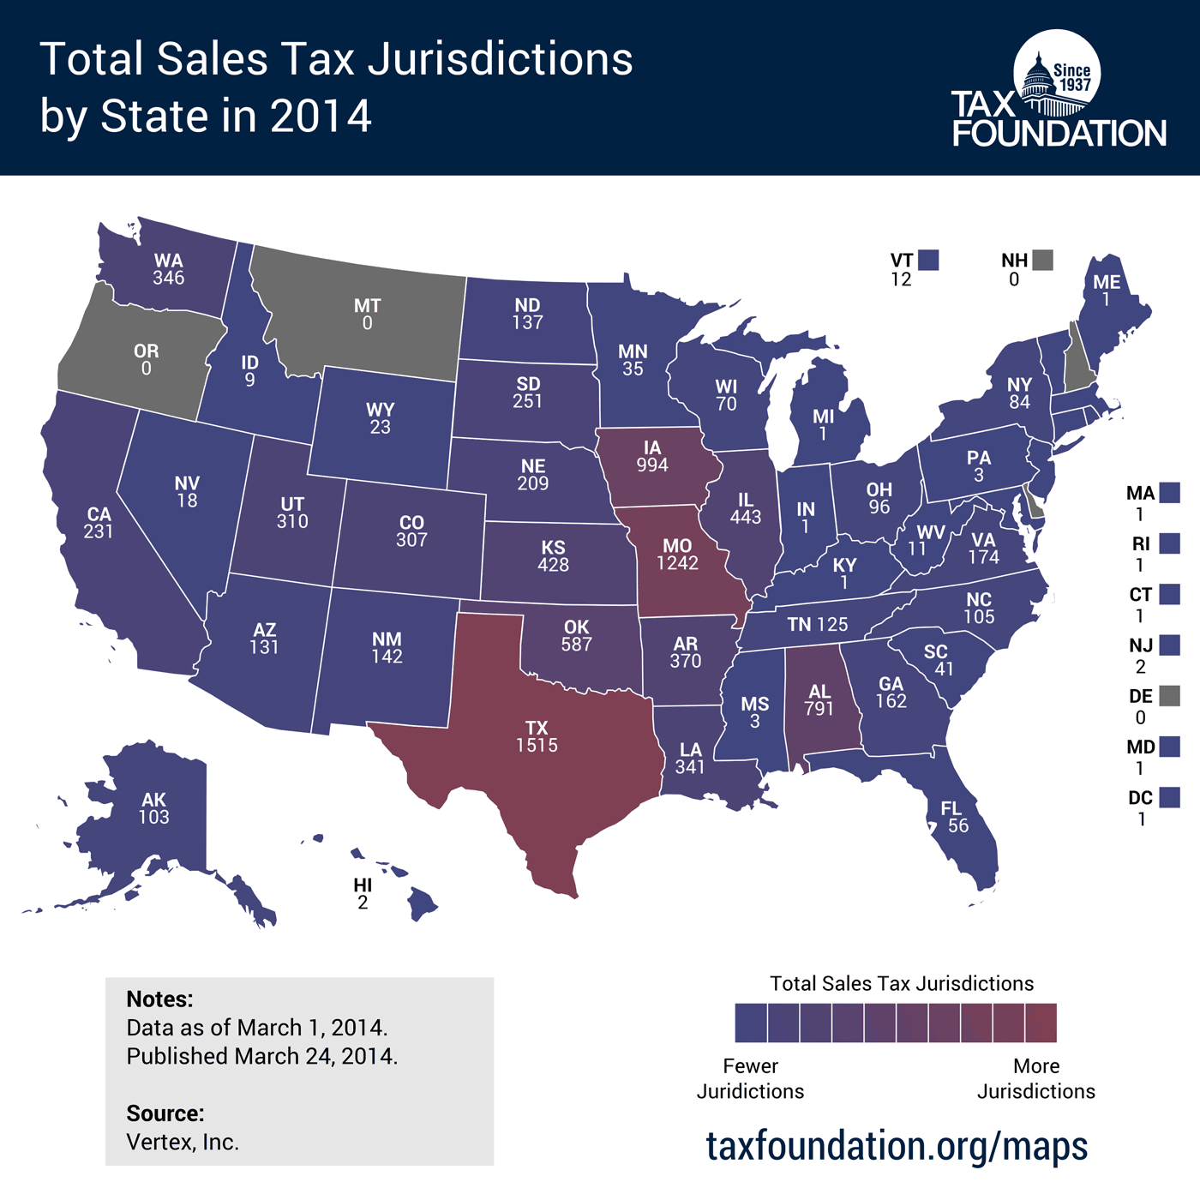

Slide 5
Streamlined Sales and Use Tax Agreement, 2000
The SSUTA’s mission is to simplify the sales tax and structure it on a destination basis so that states are better able to collect their sales taxes on remote transactions; once simplification and uniformity have been accomplished, SSUTA intends to convince Congress or the US Supreme Court to overturn the 1992 ruling so that vendors will be required to collect the sales tax.

Slide 6
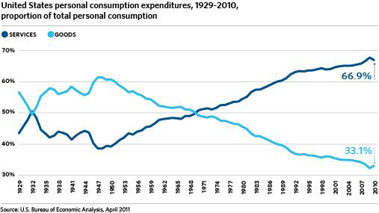
Notes:
Why’s that important? Because employment in the service sector indicates that the growth is in ‘services’ not in tangible products. The consumer’s dollar is spent on goods that are increasingly not taxed by state and local governments. Since the war, a shift in the percentage of the consumer’s dollar that is spent on “goods” (mostly taxable) and “services” (mostly not taxable) from 1/3 to 2/3, and vice versa.
Even as tax base narrows due to the tax-exempt property and non-taxed services, federal intervention reduces the base even more.
The Internet Tax Freedom Act and the Bella Hess and Quill Supreme Court decisions have effectively hidden billions of the tax base. The effect shifts the tax burden elsewhere.
Fox/Bruce estimate the retail sales tax loss at ~$116 billion in 2003 that will escalate to $35 billion (or $22 B) in 2008.

Slide 7
Source: State and Local Government Sales Tax Revenue Losses from Electronic Commerce By Donald Bruce, William F. Fox, LeAnn Luna. April 13, 2009 http://cber.utk.edu/ecomm/ecom0409.pdf

Slide 8
Lessons?
L’econmica digitale continues to challenge the public finance community, which is committed to principles of fairness, efficiency, and equity.
Federal systems respect the value of local autonomy, while the rapid pace of e-commerce may require a fiscal solution better designed by a unitary system.
The larger the number of governments to harmonize, the more difficult it is to reach agreement

Slide 9

THANK YOU
Michael Pagano (MAPagano@uic.edu)

